Slide 1

TensorFlow Lite
OSI LAB.
지도교수: 윤세영
발표자: 석사과정 김종협, 유형준

Slide 2
INTRODUCTION
What is TensorFlow Lite?
See the guide
See examples
See models
See DEMO

Slide 3
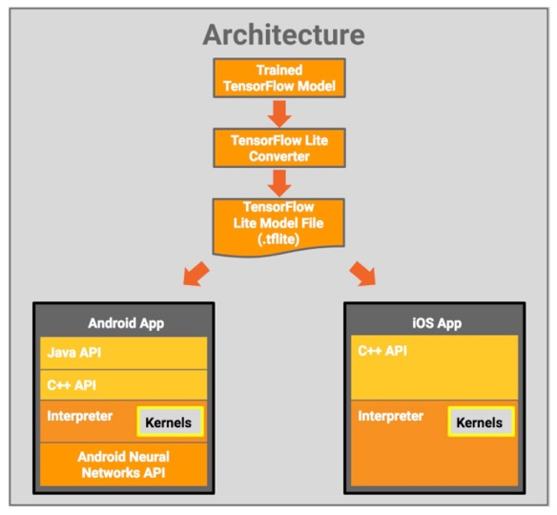
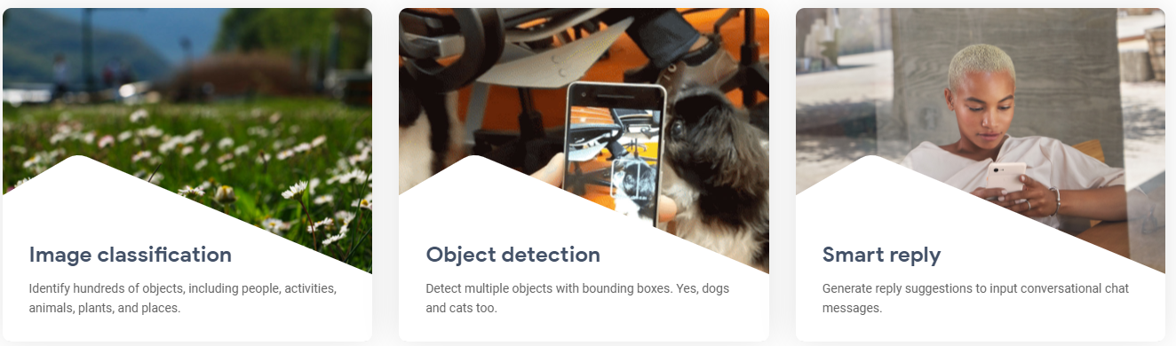
What is TensorFlow Lite?
TensorFlow Lite is an open source deep learning framework for on-device inference
TensorFlow Lite provides various solutions to common problems

Slide 4
TensorFlow Lite guide
TensorFlow Lite
a set of tools to help developers run TensorFlow models on mobile, embedded, and IoT devices.
It enables on-device machine learning inference with low latency and a small binary size.
TensorFlow Lite
interpreter
runs specially optimized models on many different hardware types.
TensorFlow Lite
TensorFlow Lite
converter
converts TensorFlow models into an efficient form.
Machine learning at the edge
Latency : no round-trip to a server
Privacy : no data needs to leave the device
Connectivity : an Internet connection isn’t required
Power consumption : network connections are power hungry

Slide 5
TensorFlow Lite guide
Development workflow
1. Pick a model
Bring your own TensorFlow model
2. Convert the model
If using a custom model, need a few lines of Python to convert it to the Tensorflow Lite format
3. Deploy to your device
Run your model on-device with the interpreter
4. Optimize your model
Use their Model Optimization Toolkit to reduce model size and increase its efficiency with minimal impact on accuracy
Technical constraints
- Do not support any TensorFlow model
- Do not currently support on-device training
TensorFlow Lite Roadmap

Slide 6
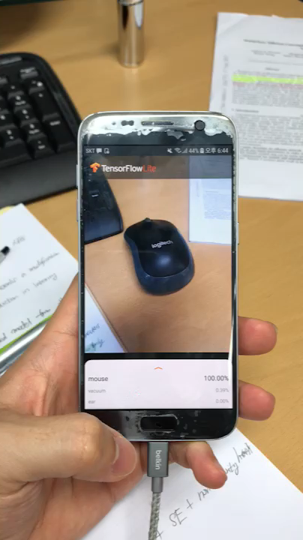
TensorFlow Lite example Video
Image Classification

Slide 7
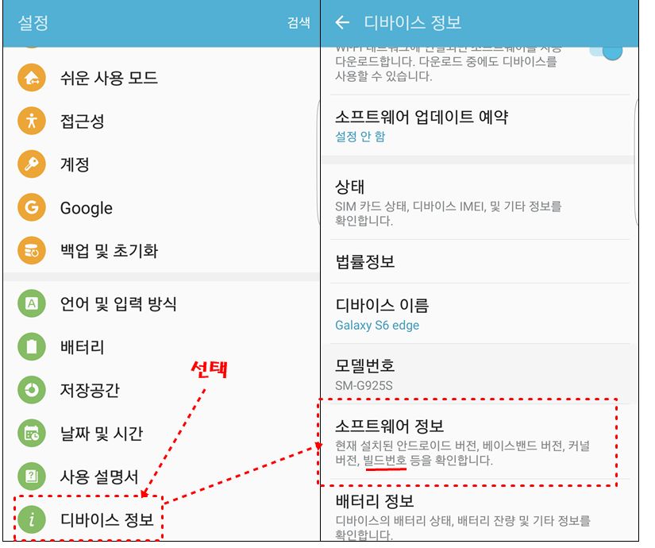
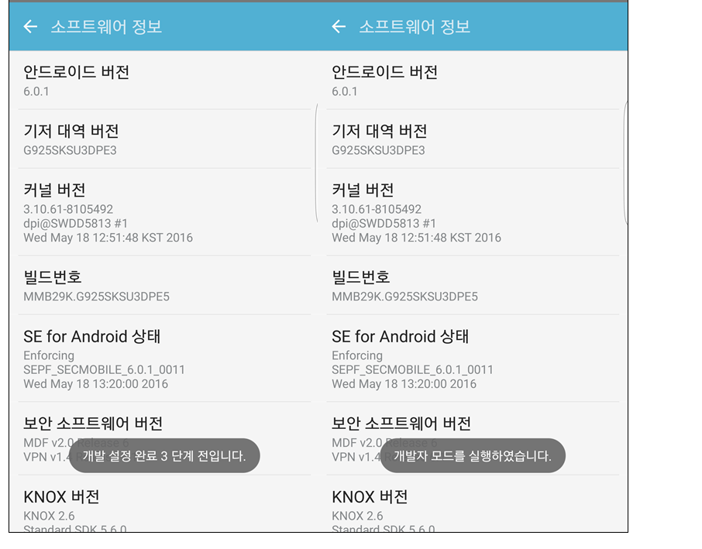
Mobile phone Setting
Before Android Studio, set the mobile phone to developer mode

Slide 8
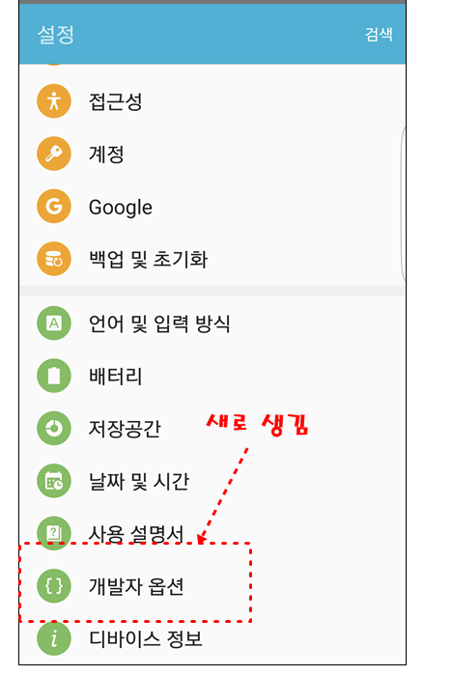
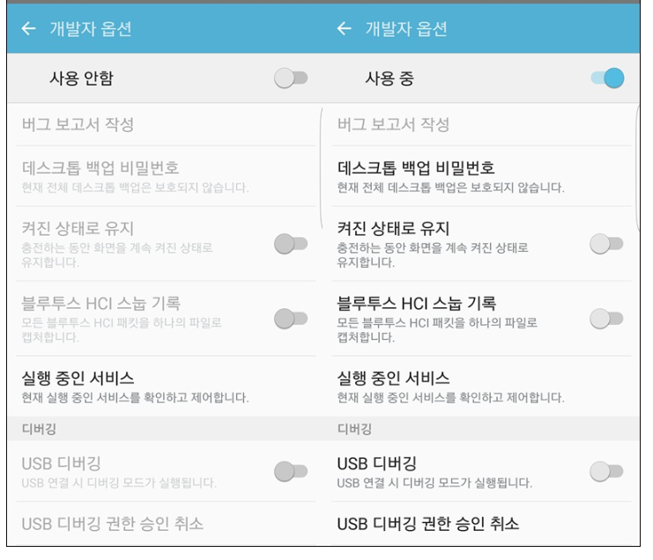
Mobile phone Setting

Slide 9
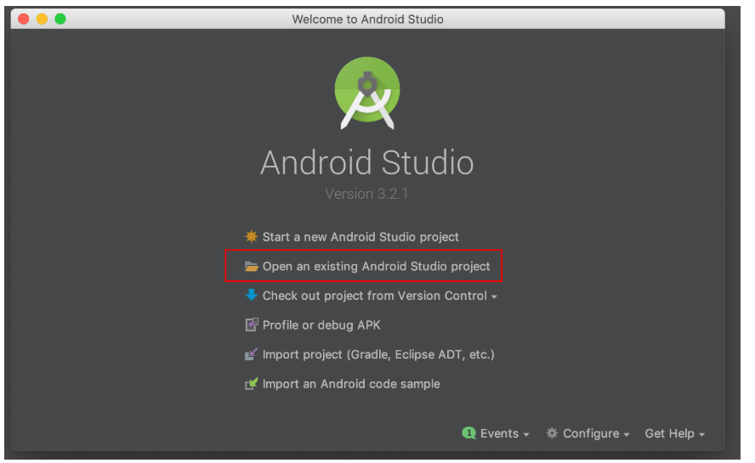
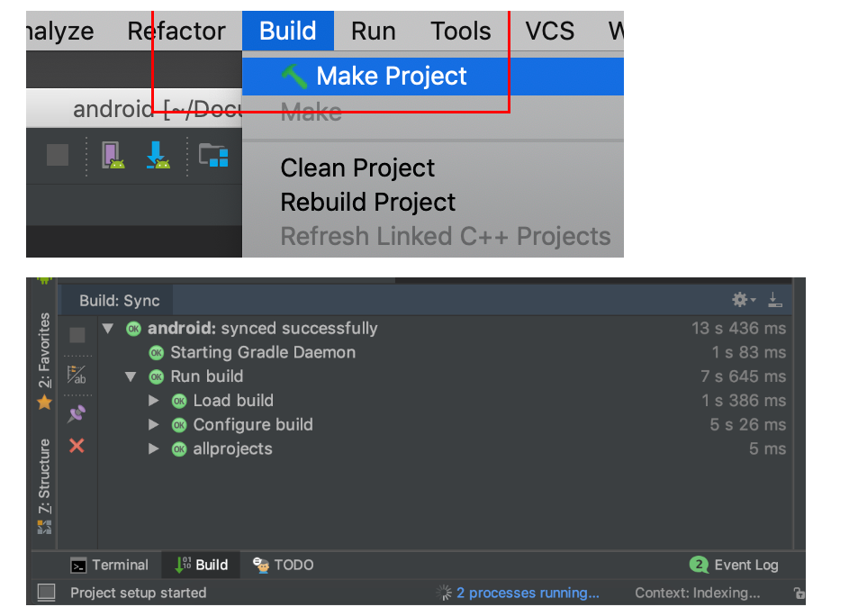
Image Classification (Android)
Through Android Studio, install the Tensorflow Lite(Image Classification) app on mobile.
Setting the folder to examples/lite/examples/image_classification/android

Slide 10
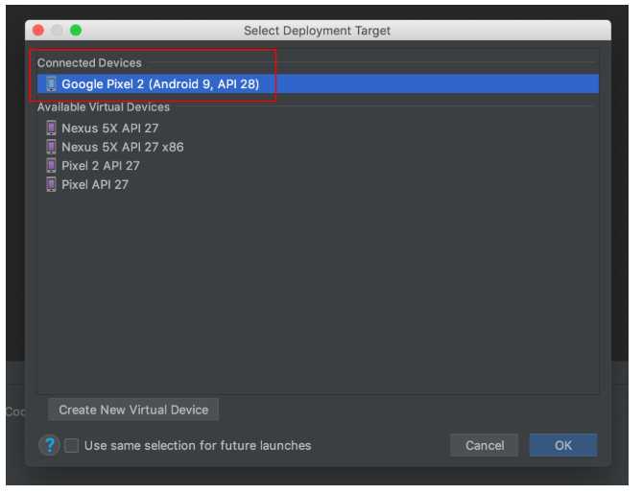
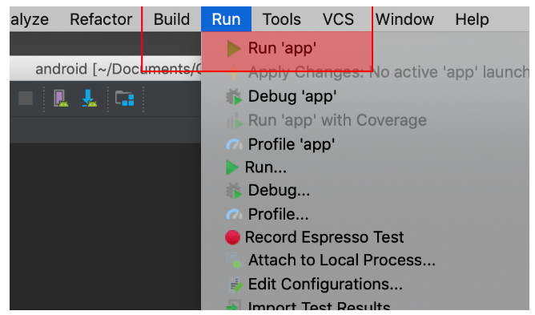
Image Classification (Android)

Slide 11
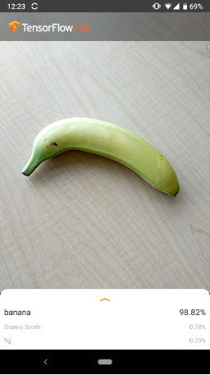
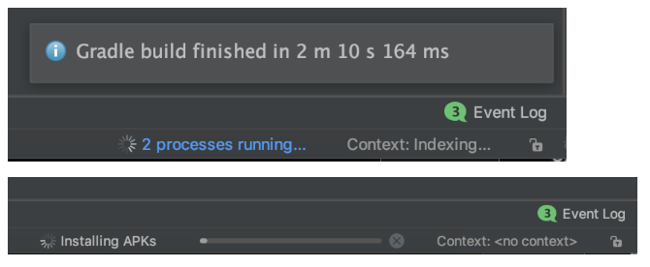
Image Classification (Android)
Classify this to ‘banana’ with TensorFlow Lite
At the end of installing, you can use TensorFlowLite app to classify the object with probability

